Slide 1
Interim results
For the period ended 31 December 2023
James Armstrong and Neil Wood
Bluefield Partners LLP

Slide 2
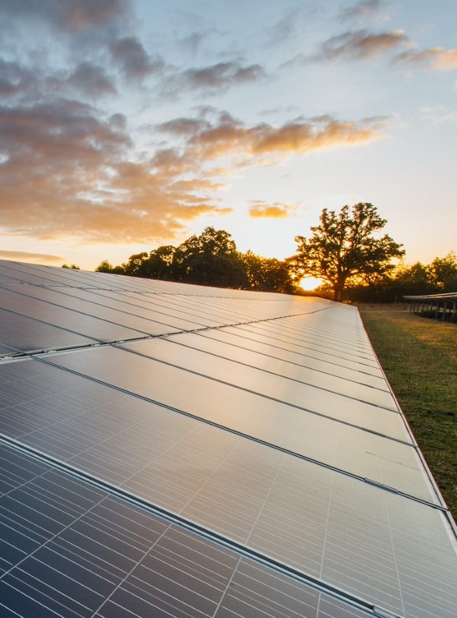
The Company
A Decade of Sustainable Returns

Slide 3
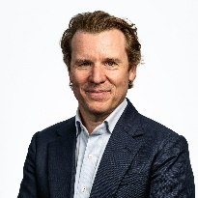
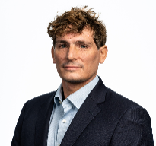
Bluefield Partners LLP
Introduction to the Investment Adviser
About Bluefield Partners LLP
Bluefield Partners LLP is a London based investment specialist who is the investment adviser to the Bluefield Solar Income Fund.
Our teams have generated above target returns for our investors across every fund we have established.
Bluefield’s approach to creating, sustaining and maximising value to the shareholders is a function of having expertise at every part of the investment cycle.
``
Speakers
James Armstrong
Neil
Wood
Bluefield Solar Income Fund Investment Mandate
Pure-play renewable energy fund, focused on solar PV
Exclusively UK focused, with at least 75% solar, with the ability to invest up to 25% in complementary renewable technologies
Sterling income with a progressive dividend policy
Maximise earnings through focusing on operational performance and PPA strategy
James Armstrong is a founder of the Investment Adviser with 17 years of renewable energy experience.
James has been involved in £1.65 billion of UK and European energy transactions and over £520 million third-party financing at Bluefield.
Neil is a partner at Bluefield Partners LLP and oversees Bluefield’s UK solar income fund.
Since joining Bluefield in 2013, Neil has been involved in over £900 million of UK solar deals and arranged in excess of £470 million of both short- and long-term 3rd party financing.

Slide 4
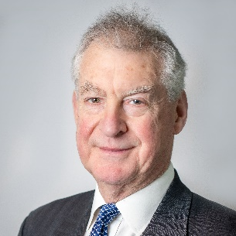
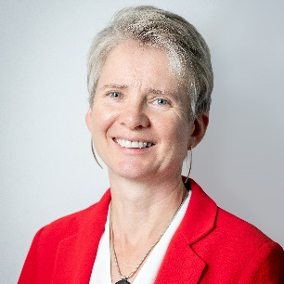
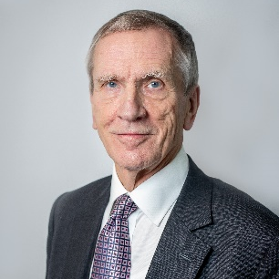
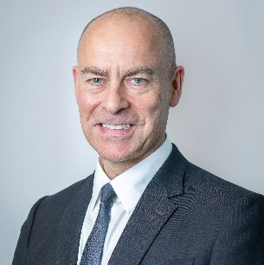
Board of directors
Introduction to the Bluefield Solar Income Fund Board
John Scott
Chair
John Scott was appointed as a non-executive director of the company on 12 June 2013 and as the Chair on 29 November 2022.
Mr. Scott is a former Investment banker who spent 20 years with Lazard and is currently a director of several investment trusts.
Meriel Lenfestev
Non-executive director
Meriel Lenfestey brings over 20 years of board level experience to Bluefield Solar.
Since 2016, Ms. Lenfestey held a portfolio of non-executive director and advisory roles across various industries.
Michael Gibbons
Senior independent non-executive director
Michael Gibbons CBE FEI has held a very wide range of senior appointments in the private and public sectors for over 20 years.
Mr. Gibbons has been in the energy industry for the main part of his career, taking senior positions in ICI, Powergen and Elexon, where he was Chair from 2013-2022.
Elizabeth (Libby) Burne
Chair of the Audit and Risk Committee
Libby Burne has over 20 years’ experience working within the financial services sector.
Ms. Burne holds a portfolio of non-executive directorships as well as a number of private companies in the venture capital, real estate and insurance sectors.
Christopher Waldron
Non-executive Director
Christopher Waldron was appointed as an independent non-executive director of the company on 1 December 2023.
Mr. Waldron brings over 35 years’ experience as an investment manager, specialising in fixed income, hedging strategies and alternative investment mandates.

Slide 5
10-year anniversary
A decade of sustainable accomplishments
July - company listed on the Premium Segment of the London Stock Exchange raising £130m
May - Bluefield Services is established
Dec – successful placement of shares raises £32m
August - Bluefield Operations is set up
Jan – Acquired Bradenstoke, a 70MW PV site for £90m
August – purchased first wind assets with a portfolio of 109 operational wind turbines for £63m, financed by an equity raise of £105m
Energisation of Yelvertoft solar farm, c. 49MW CfD project due to commence in 4Q23
IPO - 2013
2015
2017
2019
2021
2023
2014
2016
2018
2020
2022
June - Utilised a £50 million revolving credit facility arranged with Royal Bank of Scotland
September – long-term financing agreed with Aviva investors of £187m, replacing existing RCF
Oct – successful placement of new shares raises £60.6m
August – Acquired a 64MWp PV portfolio for £110m
December – Bluefield Renewable Developments (BRD) commenced
May - Acquired 93MW solar and wind portfolio for £187m
July - Raised combined £150m through equity issuance
Promoted to the FTSE 250 index

Slide 6
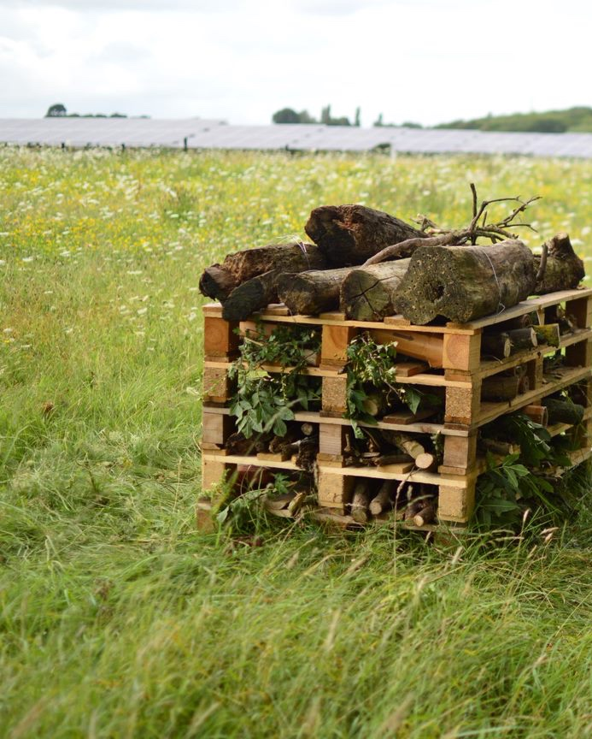
A Decade of Sustainable Returns
Introduction to Results & Key Priorities

Slide 7
Introductory remarks
High quality earnings with clear strategy for continued growth
1
Defensive capital structure with low-cost fixed debt, little interest rate risk, and active debt management
Value-added power price strategy of short-term PPAs to maximise power prices achieved
2
3
Active management across the entire value chain through integrated O&M, Asset Management and Development business
4
Proprietary pipeline of high quality, value accretive development opportunities to support future growth
Disciplined capital deployment, targeting only high-quality investments with suitable return profiles through new developments and acquisitions of operational portfolios
5

Slide 8
Priorities
Capital allocation priorities in a closed market
Reduce the RCF: find an appropriate strategy to sell down assets to achieve liquidity
1
2
Keep momentum in the business: maximise development pipeline value for shareholders
3
Management of the discount to NAV: share buybacks

Slide 9
Capital allocation strategy
A multi-layered approach
Strategic partnership with GLIL Infrastructure established
Enabling investment momentum through the acquisition of a 247MW operational portfolio and collaboration of future investment into a subset of BSIF’s AR5 CfD solar pipeline.
Sale of assets to facilitate capital recycling
Provisional agreement to divest a 50% stake in a portfolio of over 100MW of BSIF’s operational solar assets providing additional liquidity whilst equity markets remain depressed.
Share buybacks for accretive investment opportunities
Board has allocated £20 million for a share buyback programme to enable the Company to benefit from a period of excessive share price discounts.
Notes:
Box 1: Strategic partnership that allows BSIF to maintain investment momentum in a difficult time for public market infrastructure funds and judiciously diversify the portfolios revenues through the acquisition of a 247MW operational portfolio and future investment into BSIF’s high-quality, CfD eligible pipeline.
Box 2: Provisional agreement to divest a 50% stake in a portfolio of over 100MW of operational UK solar assets in line with their current carrying value. The proceeds of which will provide additional liquidity to support the continued paydown of the RCF alongside the Fund’s other strategic initiatives.
Box 3: Given the excessive discount at which the Company's shares currently trade relative to the underlying NAV, the Board has announced its intention to commence a share buyback programme. In the first instance it has allocated £20 million for the purchase of its own shares.

Slide 10
Capital allocation strategy
A challenging market backdrop
Equity market conditions have remained challenging with high base rates compressing yield spreads.
The Fund is well positioned through its defensive capital structure and proprietary pipeline to continue to successfully navigate challenging market conditions
Record earnings showcasing resilient capital structure despite share price volatility

Slide 11
A Decade of Sustainable Returns
Interim Results Highlights

Slide 12
Simple business model
Converting irradiance and wind resource to shareholder dividends
294,048 MWh
Solar irradiance and operational performance
813 MW Portfolio
82,008 MWh
Wind resource and operational performance
376,056 MWh
Energy generated from portfolio in H1 FY24
Revenues derived from long-dated index-linked regulated revenues in addition to electricity sold via PPAs on the wholesale market.
Cost base tightly controlled with underlying portfolio achieving high EBITDA margins
3.3x
Gross cash cover⁽¹⁾
£44m
Operational cash flows
(-) £22m
Debt service
Majority of principal payments made in September and December
£58m
Brought forward distributable reserves
£22m
£88m total distributable reserves
£10m
Repayment of RCF
c. 2x
Anticipated dividend cover FY24⁽²⁾
£57m
Distribution surplus after 1st FY24 Interim dividend paid⁽¹⁾

Slide 13
Key financial highlights
Overview of the key financial metrics for H1 FY24
Financial Overview
£1,412m
Gross Asset Value
136.0p
NAV per share
£44m
Operational cash flow⁽¹⁾
FY23: £1,438m
FY23: 139.7p
H1 FY23: £51m / FY23: £108m
Defensive Debt Strategy
41%
Gearing
3.5%
Average Cost of Debt⁽²⁾
12.1 years
Weighted Average Maturity ⁽²⁾
FY23: 41%
FY23: 3.5%
FY23: 12.6 years
Attractive Dividend
c. 2x
Forecast FY24 dividend cover
8.80p
FY23/24 dividend target
c. 8.6%
Dividend yield⁽⁴⁾
FY23: 2.1x
FY23: 8.40p⁽³⁾
FY23: 7.3%⁽⁵⁾

Slide 14
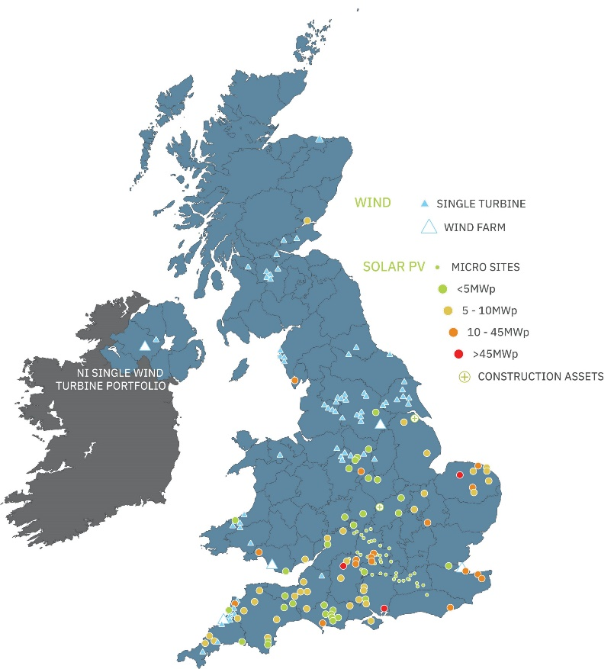
Portfolio overview
Robust UK renewable asset portfolio with high visibility of income
Key Highlights
Subsidy Split⁽¹⁾
Technology Mix⁽²⁾
27.1
Wtd. avg. asset life remaining (years)
813MW
Operational solar and wind capacity
200+
Operating assets
All operational assets in the portfolio receive subsidies
Solar focus with some wind to offer complementary generation profile
Geography
1.55⁽³⁾ ROCs/MWh
Limited Asset Concentration Risk
40%
Top 10 assets by capacity

Slide 15
Portfolio revenue mix
Highly fixed, inflation-linked revenues with limited power price risk
Fixed revenue makes up 66% of total revenue out to 2034 on a discounted basis.
Fixed revenues are projected to increase from the completion of construction of CfD-backed projects. The additional fixed revenues included in the chart below are from our AR4 projects.
High Proportion of Fixed, Inflation-Linked Revenues (£m) for 10+ Years⁽¹⁾

Slide 16
Dividend track record
Steady, growing dividend with high visibility of future cash flows
93%
Total return to Shareholders since IPO⁽¹⁾
£301m
Dividends paid/announced since IPO⁽²⁾
c. 2x
Forecast dividend cover for FY24
8.80p
FY23/24 dividend target ⁽²⁾
8.80p

Slide 17
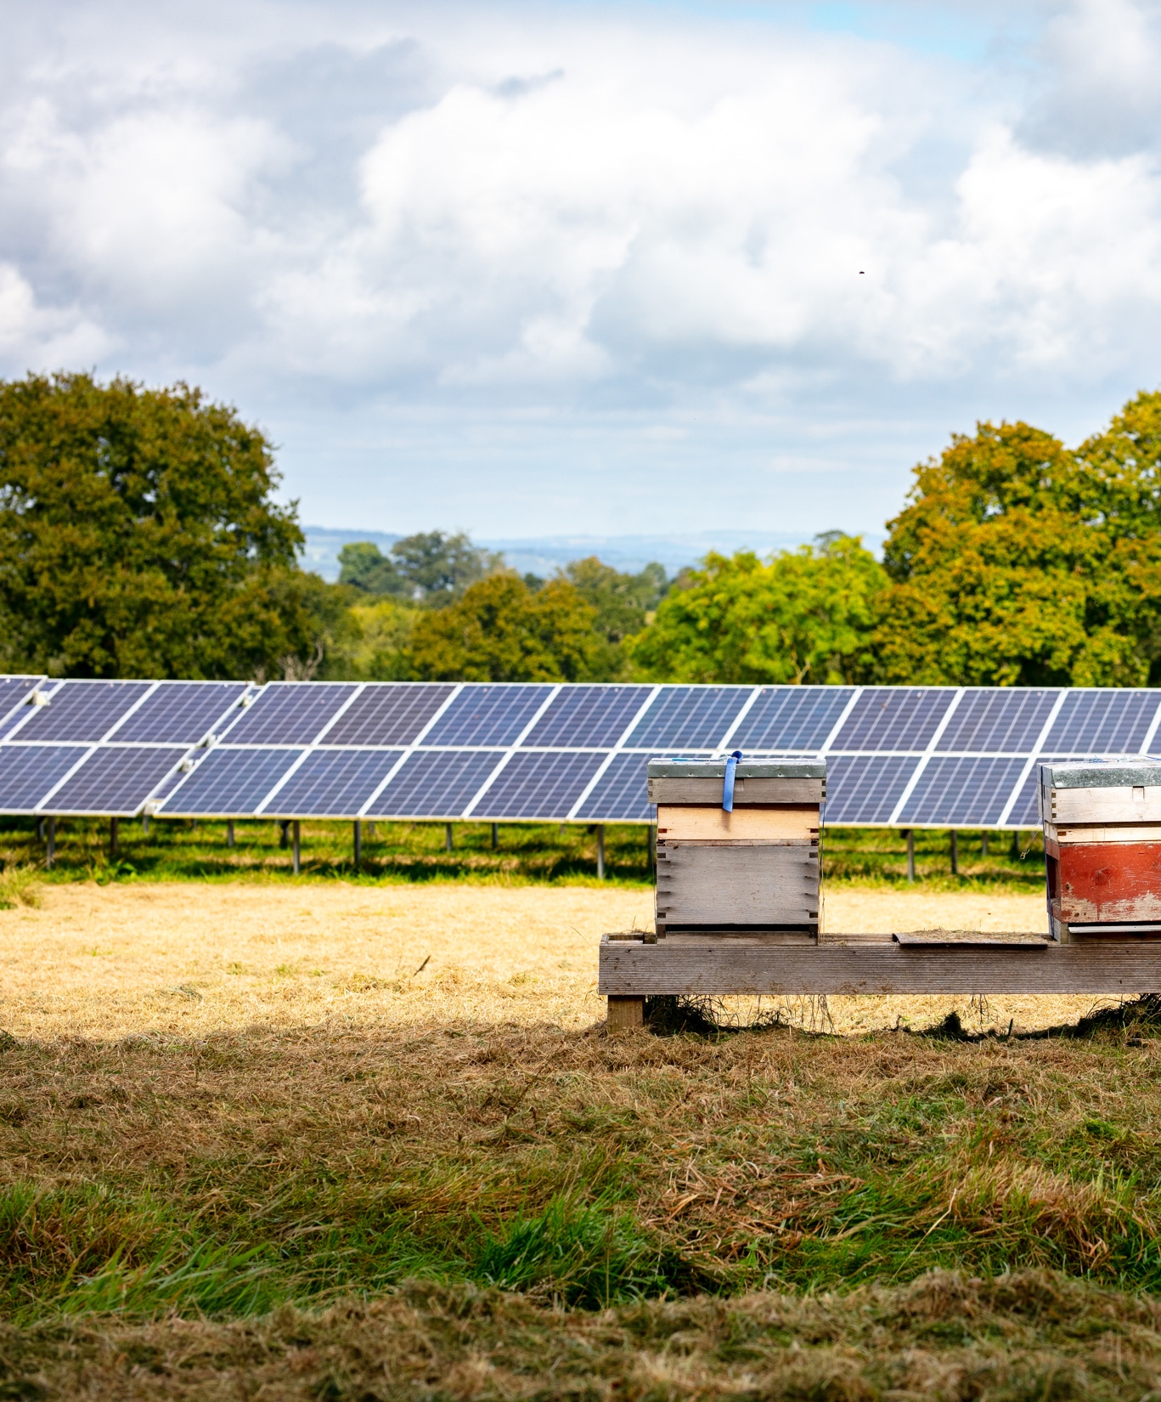
A Decade of Sustainable Returns
Valuation, Capital Structure, & Active Management

Slide 18
Capital Structure
Consistently defensive debt strategy since IPO
Breakdown of debt by structure
Breakdown of long-term debt:
£410m at all in cost of 3.5%
HoldCo level Revolving Credit Facility (up to 3 years)
Long-term debt at HoldCo level, fully amortising with an average duration of c. 12 years remaining
Notes:
3.5% weighted-average cost of long-term debt as at Jun-23
12.1 years weighted-average maturity

Slide 19
NAV bridge: 6-month period
Positive impact of inflation offset by dividend payments
Updated ROC inflation for April 2024 following higher levels of inflation through 2023
Change in power price forecasts in the year by independent forecasters
Payment of the FY23 4th interim dividend
Value from recognising consented developments
Inclusion of REGOs to 2030
Actual operational performance and updated operational cost profiles
Payment of the FY23 3rd interim dividend
Notes:
REGOs:
BSIF has recognised value from Renewable Energy Guarantees of Origin certificates (“REGOs”) for the first time due to sustained market prices over the last 12 months and expectations of future value from forecasters.
The REGO scheme provides transparency to consumers about the proportion of electricity that suppliers source from renewable energy.
One REGO certificate is issued by Ofgem per megawatt hour (MWh) of eligible renewable output to generators of renewable electricity, these can be trades with suppliers and offtakers to guarantee that energy sources are renewable.
Value has only been recognised out to 2030 until there is further evidence to show values are maintained in the market
REGO pricing, based on an independent forecaster’s view has only been included from the point at which the majority of the existing PPA fixes roll-off.

Slide 20
Active management
Proactive and innovative approach to enhance shareholder value
Value enhancement
Strategic investment activity
Operational performance
Power price
strategy
Specialist teams established over the past decade to deliver an aligned, dedicated and diversely skilled workforce to an increasingly complex business
Notes:
Active Management: Active Management a much used, and misused, term in investment. What is means in the context of Bluefield Solar’s portfolio is a dedicated team of [115] people at the time of writing (and growing) covering all aspects of the value chain of long dated renewable energy assets, from development through to operations and covering everything in between. Bluefield Partners and Services have specialist teams covering primary investment, secondary investment, ESG, development, engineering, construction management, monitoring and reporting, debt compliance, technical asset management, operation and maintenance and commercial with [87] different jobs titles and core responsibilities. These specialist units have been established in the past decade to deliver an aligned, dedicated and diversely skilled workforce to an increasingly complex business.

Slide 21
PPA strategy
Power sales optimisation underpinning strong earnings
Power sales strategy of securing short-term PPAs smooths out the volatility in electricity markets
Competitive tender processes run regularly for fixed and floating price contracts, with flexibility to secure contracts for varying durations, typically 6-30 months, to maximise value
Fixed PPAs at Attractive Levels vs Forecast Power Prices⁽¹⁾
88% of Capacity Fixed
73% of Capacity Fixed
60% of Capacity Fixed
58% of Capacity Fixed
Highly Fixed Short-Term Revenues
(PPAs and Subsidies)⁽²⁾
2024
90% Fixed
2025
78% Fixed
2026
58% Fixed
2027
59% Fixed

Slide 22
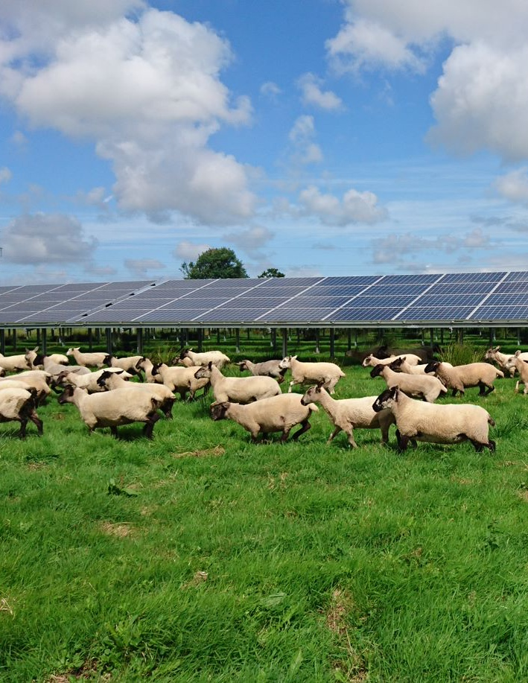
A Decade of Sustainable Returns
Future pipeline, ESG, & Regulatory Outlook

Slide 23
Development and construction strategy
227MW of planning permissions secured during the period
The current value of the construction projects and consented projects in the BSIF valuation is £95.6m.
The development pipeline offers both capital recycling opportunities (through disposals of projects) and future investment opportunities (with subsidised and unsubsidised revenue streams).
871 MW
Notes:
Text on LHS may be slimmed down (TBC)

Slide 24
ESG strategy
Renewable Energy, Delivered Responsibly
Company ESG Strategy
Material ESG risks and opportunities are reflected within the Company’s ESG strategy: a framework through which the Company delivers value for its stakeholders, and which will support delivery of long-term returns for shareholders
CLIMATE CHANGE MITIGATION
Supporting the UK in achieving its Net Zero Carbon ambition whilst aligning to the TCFD recommendations
PIONEERING POSITIVE LOCAL IMPACT
Enhancing nature and encouraging community engagement at the local level throughout the asset lifecycle
GENERATING ENERGY RESPONSIBLY
Driving ethical practices within our operations and throughout our supply chain
Notes:
Text on LHS may be slimmed down (TBC)

Slide 25
Energy Regulatory Environment
Supporting the journey to net zero
Contracts for Difference (CfD) low-carbon support scheme
Engaged in the Department for Energy Security and Net Zero (DESNZ) consultation on proposed amendments for AR7 and future rounds
Fixed Price Certificates (FPCs)
Participating in DESNZ led workshops related to the minded transition from Renewable Obligation Certificates to FPCs anticipated in late 2020s
Electricity Generator Levy (EGL)
The UK EGL is still legislated to remain in force until 31 March 2028 for operational plants
Confirmation the EGL would no longer apply to solar projects constructed post November 2023

Slide 26
A Decade of Sustainable Returns
Concluding Remarks

Slide 27
Concluding remarks
High quality earnings with clear strategy for continued growth
1
Defensive capital structure with low-cost fixed debt, little interest rate risk, and active debt management
Value-added power price strategy of short-term PPAs to maximise power prices achieved
2
3
Active management across the entire value chain through integrated O&M, Asset Management and Development business
4
Proprietary pipeline of high quality, value accretive development opportunities to support future growth
Disciplined capital deployment, targeting only high-quality investments with suitable return profiles through new developments and acquisitions of operational portfolios
5

Slide 28
Disclaimer And Important Notice
This Annual Results Presentation (the Presentation) in relation to the Bluefield Solar Income Fund Limited (BSIF) is being made and this document is being issued by Bluefield Partners LLP (Bluefield), which is authorised and regulated in the United Kingdom by the Financial Conduct Authority.
Confidentiality: This Presentation has been prepared solely for the use of the intended recipient and should not be distributed to or relied upon by any other person. This Presentation should not be taken away, reproduced, redistributed or passed on, in whole or in part, to any other person without Bluefield’s consent, other than as required by law or regulation, and must be returned on request to Bluefield and any copies thereof destroyed. By accepting this Presentation, the recipient agrees to keep confidential at all times information contained in it or made available in connection with it.
No Offer: This Presentation is provided for informational purposes only and does not constitute an offer to sell, or the solicitation of an offer to buy, any securities in any jurisdiction. In particular, this presentation is not directed at, or intended for distribution to or use by, any person or entity that is a citizen or resident or located in any jurisdiction where such distribution, publication, availability or use would be contrary to applicable law or regulation or would require any registration or licensing within such jurisdiction. This Presentation does not constitute or form part of, and should not be construed as, any offer for sale, placement or subscription of, or solicitation of any offer to buy or subscribe for, any interests in any fund and/or vehicle in any jurisdiction, including the United States, nor should it or any part of it form the basis of, or be relied on in connection with, any contract or commitment whatsoever in any jurisdiction, including the United States.
Not Advice: The information contained in this Presentation is not intended to be, and should not be construed as, investment, financial, legal, tax or other advice, and is not a recommendation, endorsement or representation as to the suitability of any investment. You should seek independent professional advice before making any investment decision.
Accuracy: This Presentation has not been verified and is not and should not be construed as an offer to sell or the solicitation of an offer to purchase or subscribe for any investment, is intended for information purposes only and does not constitute investment advice. The information and opinions contained in this Presentation are for background purposes only and do not purport to be full or complete. The information contained in this Presentation is based on publicly available information, internally developed data and other sources believed to be reliable, but no representation or warranty, express or implied, is made as to the accuracy, completeness or reliability of such information. Any projections or other forward-looking statements contained in this presentation are based on assumptions that may change and actual results may differ materially from those expressed or implied in such projections or statements. No representation or warranty is given by Bluefield or any of its or their respective affiliates, related bodies, partners, shareholders, officers, employees, representatives or advisers (the Parties) as to the accuracy or completeness of any statement, information, opinion or conclusion contained in this Presentation, nor will any of the Parties, to the extent permitted by law, be liable or responsible for any loss or damage suffered as a result of or in connection with any omission, inadequacy, incompleteness or inaccuracy of this Presentation.
No Reliance: This Presentation must not be taken as the basis of any investment decision. Any investment in a fund or investment vehicle involves significant risk, including the risk of loss of capital invested. Any investment decisions must be based upon an investor’s specific financial situation and investment objectives and should be based solely on the information in any final offering documents of BSIF. This Presentation includes track record information and performance data regarding Bluefield, BSIF, Bluefield Services Limited and Bluefield Operations Limited (the Bluefield Group). Such information is not necessarily comprehensive and potential investors should not consider such information to be indicative of the possible future performance of the Bluefield Group or any investment opportunity to which this Presentation relates.
Track Record: This Presentation contains track record information and performance data regarding BSIF to which Bluefield is the investment adviser, or any other fund advised by Bluefield. Such information is not necessarily comprehensive and users should not consider such information to be indicative of the possible future performance of BSIF. Past performance of BISF or other funds previously or currently advised by Bluefield are not a reliable indicator and cannot be relied upon as a guide to future performance of BSIF or Bluefield.
Past performance is not indicative of future results; no representation is being made that any investment will or is likely to achieve profits or losses similar to those achieved in the past, or that significant losses will be avoided. Capital at Risk.
Forward Looking Statements: This document may include “forward looking statements”. Such forward-looking statements are subject to various risks and uncertainties and speak only as of the date on which they are made. Accordingly, there are or will be important factors that could cause actual outcomes or results to differ materially from this indicated in these statements. You can identify these forward-looking statements by the use of words such as “outlook,” “indicator,” “believe,” “expect,” “potential,” “continue,” “may,” “should,” “seek,” “approximately,” “predict,” “anticipate,” “optimistic,” “intend,” “plan,” “estimate,” “aim,” “will” or the negative version of these words or similar expressions. All statements other than statements of historical facts included in this document, including, without limitation, those regarding the Company’s financial position, business strategy, plans and objectives of management for future obligations (including development plans and objectives relating to the Fund's investments) are forward-looking statements. The Fund's actual future financial results and operational performance may differ materially from the results and performance expressed in, or implied by, the statements. These factors include but are not limited to those described in the presentation. Any obligation or undertaking to update or revise any forward-looking statements contained herein to reflect actual results or any change in the assumptions, conditions or circumstances on which any such statements are based is expressly disclaimed (unless required to do so by applicable laws, regulations or rules).
Accuracy: This presentation and any information contained in it may be amended or withdrawn at any time without notice. The information in this Presentation has not been audited or verified by any third party and is subject to change at any time without notice. Certain information contained herein was based on or obtained or derived from data published or prepared by parties outside the Bluefield Group, which whilst believed to be reliable, Bluefield and the Bluefield Group take no responsibility for the accuracy of any third-party information. No entity or personnel within the Bluefield Group makes any representation or warranty, express or implied, as to the accuracy or completeness of any third-party information or any opinions contained in this presentation. No entity or personnel within the Bluefield Group shall have any liability to any recipient of this presentation or any other person relating to or resulting from the use of or reliance on any such information contained within this Presentation or any errors or omissions related to such information.

Slide 29
Disclaimer And Important Notice
Third Party Websites: This presentation may contain references to websites operated by third parties. Any references to such third-party websites in this Presentation is in no way an endorsement by Bluefield of these sites. Bluefield does not monitor, edit or control such third-party sites and is not responsible in any way for the suitability of their content or for the quality of the products or services offered therein. Your choice to visit such websites is at your sole risk. If you have any questions regarding a website referenced in this Presentation, please direct them to the administrator of the relevant website.
Third Party Trademarks: Any third-party trademarks, trade names and service marks included within this Presentation are the property of the owners thereof and are used for reference purposes only. Such use should not be construed as an endorsement of such products or services.
No Approval By Regulatory Authorities: The contents of this Presentation have not been approved by any supervisory authority or securities commission in any jurisdiction.
United Kingdom (UK): The issue, communication, or distribution in the UK of this Presentation is being made only to, or directed only at persons falling within one or more of the following exemptions from the promotion of unregulated collective investment schemes regime in section 238 of the Financial Services and Markets Act 2000, as amended from time to time (FSMA): (i) authorised firms under FSMA and certain other investment professionals falling within Article 14 of the FSMA (Promotion of Collective Investment Schemes) (Exemptions) Order 2001, as amended (CIS Order) and their directors, officers and employees acting for such entities in relation to investment; (ii) high value entities fatling within Article 22 of the CIS Order and their directors, officers and employees acting for such entities in relation to investment; (iii) persons to whom it may otherwise lawfully be distributed under the CIS Order or Section 4.12 of the FCA's conduct of business sourcebook, as applicable. The distribution of this Presentation to any other person in the UK is unauthorised and may contravene FSMA. No person falling outside such categories should treat this Presentation as constituting a promotion to them, or rely or act on it for any purposes whatsoever.
Reliance on this Presentation for the purpose of engaging in investment activity may expose the recipient to a significant risk of loss or of incurring additional liability. If the recipient is in any doubt about the investment activity to which this Presentation relates, they should consult an authorised person who specialises in advising on such transactions or investment activity. For the avoidance of doubt, this Presentation does not constitute a direct or indirect offer or placement of any fund interests in an “alternative investment fund” or “AIF” for the purposes of the Alternative Investment Fund Managers Directive (2011/61/EU) and related implementing measures in any relevant jurisdiction (the AIFMD). Any references to EU law or the relevant provisions thereof should also be read as references to equivalent or similar UK domestic laws which may continue to apply in the UK following its exit from the EU.
European Economic Area (EEA): This Presentation is a marketing communication. Please refer to the prospectus of BSIF before making any final investment decisions. For the avoidance of doubt, this Presentation does not constitute a direct or indirect offer or placement of any fund interests in an “alternative investment fund” or “AIF” for the purposes of the AIFMD. This Presentation does not constitute or form part of, and should not be construed as, any offer for sale, placement or subscription of, or solicitation of any offer to buy or subscribe for, any Interests in any investment vehicle in any jurisdiction, including the United States, nor should it or any part of it form the basis of, or be relied on in connection with, any contract or States. A formal offer will be made only on registration under Article 42 of the AIFMD or otherwise any other marketing notification or registration process permitted in compliance with the provisions of the AIFMD.
United States of America: Interests in BSIF will not be registered under the U.S. Securities Act of 1933, as amended, or any state or non-U.S. securities laws, or with any non-U.S. securities regulator, and BSIF will not be registered under the U.S. Investment Company Act of 1940, as amended.
Guernsey: The Fund is a closed-ended collective investment scheme registered pursuant to the Protection of Investors (Bailiwick of Guernsey) Law 1987, as amended and the Registered Collective Investment Scheme Rules 2008 issued by the Guernsey Financial Services Commission (the GFSC). The GFSC, in granting registration, has not reviewed this document but has relied upon specific warranties provided by Heritage International Fund Managers Limited, the Fund’s administrator. The shares are listed on the London Stock Exchange’s Main Market for listed securities.
Market Abuse: This Presentation contains or may contain inside information for the purposes of Article 7 of the EU Market Abuse Regulation (EU) 596/2014, as amended (MAR) and material non-public information for the purposes of the US insider trading regime. You hereby acknowledge that you are aware that this Presentation contains or may contain (1) “material, non-public information” within the meaning of the US insider trading regime, and (2) “inside information” within the meaning of MAR, concerning current or prospective Bluefield Group investments. You agree, and agree to advise your representatives and affiliates, who will hereby be deemed to have agreed, that: (1) applicable law, including US securities laws, prohibit any person who has material, non-public information about a company from: (a) purchasing or selling securities of such company (or attempting to do so) or from communicating such information to any other person under circumstances in which it is reasonably foreseeable that such person is likely to purchase or sell such securities; (b) any unlawful disclosure of such information; and (c) any actual or attempted market manipulation, and you hereby agree to refrain from purchasing or selling such securities or communicating such information to others; (2) the EU market abuse regime prohibits the following behaviours: (a) actual or attempted dealing in securities on the basis of inside information relating to those securities, including by trading or by cancelling or amending an order; (b) unlawful disclosure of inside information; and (c) actual or attempted market manipulation, and you hereby agree to refrain from engaging in these prohibited behaviours and otherwise comply with the requirements of the MAR in respect of such information.
Please note that for additional and important disclosure information, you should refer to the footnotes and endnotes contained within each section of this Presentation, as applicable.

Slide 30
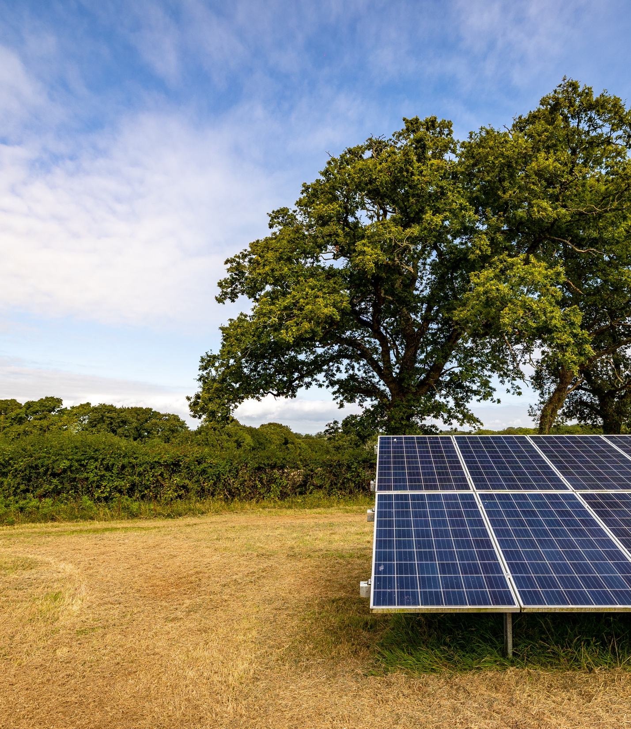
A Decade of Sustainable Returns
Appendix

Slide 31
Bluefield Group
Differentiated, end-to-end platform

Slide 32
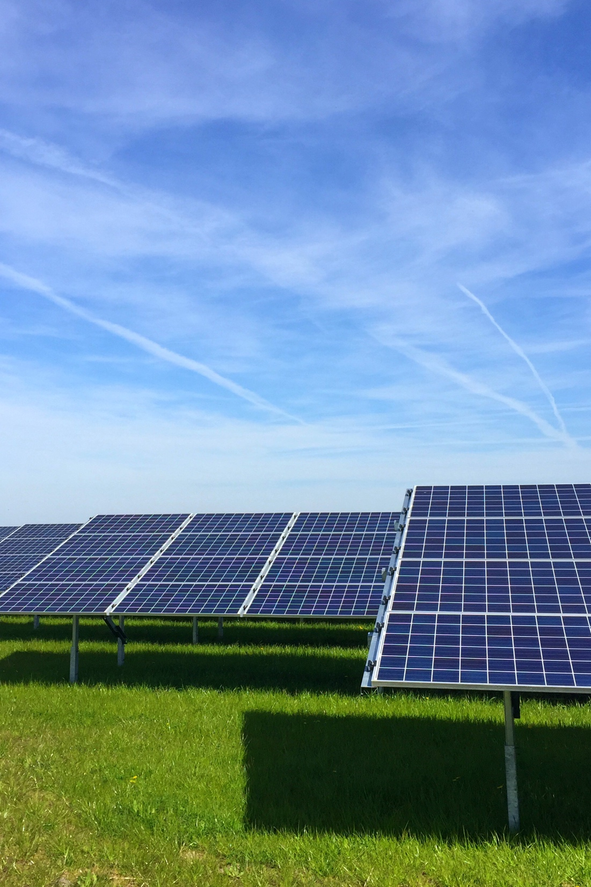
Construction projects
93MW of solar PV progressing through construction
Partnered with two contractors with deep experience in the UK solar market (Bouygues Energies & Services and EQUANS) for the delivery of the projects
The Bluefield Group progressed the site to ready-to-build status, oversaw construction, and performed a full ESG assessment of procurement and supply chain processes, providing services across the full lifecycle
Close collaboration with ecologists and archaeologists ensured that the solar farms have been constructed in a considerate manner
Both sites are expected to be fully operational in the first half of 2024 and will add c. 11% to the Fund’s generating capacity

Slide 33
Phased partnership with GLIL
Phase I: Acquisition of 247MWp operational portfolio
Phase II: Sale of 50% stake in c. 100MWp of BSIF’s operational assets in line with carrying value
Phase III: Co-investment in a subset of BSIF’s development pipeline

Slide 34
Capital allocation strategy
Disciplined approach to the deployment of capital
The Company has focussed on making high quality investments with attractive returns that complement the existing portfolio, deploying over £1,000m since IPO.
This has allowed the company to develop a material and accretive proprietary primary pipeline whilst continuously evaluating opportunities to acquire operational portfolios.
The operational cashflows from these investments has led to a dividend surplus, and the ability to reinvest cashflows into our proprietary pipeline.
£665m
Equity Deployed
£831m
Net Asset Value
£1,407m
Gross Asset Value
813MW
Operational Capacity
£301m
Total Dividends Paid/Announced⁽⁴⁾

Slide 35
Capital structure
Overview of debt
The below shows a detailed breakdown of BSIF’s external debt
A high proportion of debt has a fixed interest rate meaning the relatively low cost of debt is “locked in”
No imminent maturity dates for external debt and all external debt⁽¹⁾ is amortising, limiting refinancing risk
Several debt tranches held at HoldCo level above the underlying assets, resulting in less stringent lender requirements for PPAs, allowing BSIF to take advantage of a more flexible PPA strategy and access more competitive pricing
Lender | Category | Principal Outstanding (£m) | Maturity | % Interest Fixed⁽²⁾ | All-in Interest Rate
Syndicate | Fund RCF | 167 | May-25 | 0% | SONIA + 1.9%
Bayern LB | Project-level | 7 | Sep-29 | 100% | 5.50%
Syndicate | Project-level | 68 | Dec-33 | 100% | 3.50%
Aviva | Project-level | 83 | Sep-34 | 100% | 2.88%
Aviva⁽³⁾ | Project-level | 64 | Sep-34 | 100% | 3.70%
Macquarie | Project-level | 7 | Mar-35 | 100% | 4.60%
Macquarie⁽³⁾ | Project-level | 20 | Mar-35 | 100% | 4.70%
Gravis | Project-level | 37 | Jun-35 | 100% | 6.48%
NatWest | Project-level | 123 | Dec-39 | 85% | 2.70%
Total/Wtd Avg |  | 577 |  | 68% | 4.36%
Total/Wtd Avg excl. RCF |  | 410 |  | 96% | 3.55%

Slide 36
NAV sensitivities
Based on portfolio as at 31 December 2023
Movement in NAV (£m) based on changes in key assumptions

Slide 37
Investment performance
BSIF total return has outperformed UK equities and RPI
Since 1 Jan 2014 (first full year after IPO), BSIF’s total return has significantly outperformed broader UK equities and RPI inflation

Slide 38
Fund statistics
Key fund policies
Fund structure | Guernsey-domiciled closed-end investment company
Listing | London Stock Exchange Premium Segment (LSE: BSIF) FTSE-250 index member
Launch date | July 2013
Return target | Quarterly dividends with a target aggregate dividend of not less than 8.80 pence per ordinary share for the year to 30 June 2024
Investment policy | Geographically focused on the United Kingdom Investment Restrictions (by % of Gross Asset Value at the time of investment): 25%: non-solar renewable energy assets (including non-subsidised assets) and energy storage assets 10%: non-UK assets within portfolios containing a mix of UK and non-UK assets 5%: UK solar development opportunities that are pre-construction and may be without planning approvals or grid availability. Investment Restrictions (by % of Net Asset Value at the time of investment): 25%: no single asset The portfolio shall at no time consist of fewer than ten individual assets. The full investment policy may be found on the Company’s website: https://bluefieldsif.com/investors/investment-policy/
Leverage | Non-recourse finance may be used at the SPV level to provide leverage for specific assets or portfolios provided that total non-recourse financing within the portfolio does not exceed 50%. At holding company level, the Company may make use of both short-term debt finance and long-term structural debt that does not exceed 50% of the Gross Asset Value when taken together with SPV debt.
Management fee | 0.80% per annum of the NAV up to and including £750m; 0.75% per annum of the NAV above £750m and up to and including £1.0bn; and 0.65% of the NAV above £1.0bn
Governance | Fully independent board of five non-executive directors

